Slide 1
OSS DevOps
Notes:
Information in this document, including URL and other Internet Web site references, is subject to change without notice. Unless otherwise noted, the example companies, organizations, products, domain names, e-mail addresses, logos, people, places, and events depicted herein are fictitious, and no association with any real company, organization, product, domain name, e-mail address, logo, person, place or event is intended or should be inferred. Complying with all applicable copyright laws is the responsibility of the user. Without limiting the rights under copyright, no part of this document may be reproduced, stored in or introduced into a retrieval system, or transmitted in any form or by any means (electronic, mechanical, photocopying, recording, or otherwise), or for any purpose, without the express written permission of Microsoft Corporation.
Microsoft may have patents, patent applications, trademarks, copyrights, or other intellectual property rights covering subject matter in this document. Except as expressly provided in any written license agreement from Microsoft, the furnishing of this document does not give you any license to these patents, trademarks, copyrights, or other intellectual property.
The names of manufacturers, products, or URLs are provided for informational purposes only and Microsoft makes no representations and warranties, either expressed, implied, or statutory, regarding these manufacturers or the use of the products with any Microsoft technologies. The inclusion of a manufacturer or product does not imply endorsement of Microsoft of the manufacturer or product. Links may be provided to third party sites. Such sites are not under the control of Microsoft and Microsoft is not responsible for the contents of any linked site or any link contained in a linked site, or any changes or updates to such sites. Microsoft is not responsible for webcasting or any other form of transmission received from any linked site. Microsoft is providing these links to you only as a convenience, and the inclusion of any link does not imply endorsement of Microsoft of the site or the products contained therein.
© 2017 Microsoft Corporation. All rights reserved.
Microsoft and the trademarks listed at https://www.microsoft.com/en-us/legal/intellectualproperty/Trademarks/Usage/General.aspx are trademarks of the Microsoft group of companies. All other trademarks are property of their respective owners.

Slide 2
Abstract and learning objectives
In this whiteboard design session, you will design a plan for migrating a Linux based web application to Microsoft Azure that takes advantage of existing open-source software (OSS) skills such as usage of Jenkins. This whiteboard design session will explore options for running Linux, such as virtual machines, or Azure PaaS services, such as Web Apps and Azure Database, for MySQL.
At the end of this whiteboard design session, you will be better able to design solutions that use complex OSS workloads using Azure.

Slide 3
Step 1: Review the customer case study
Outcome
Analyze your customer needs.
Timeframe
15 minutes

Slide 4
Customer situation - Trey Research
Online vitamins seller based out of Europe.
Online presence only.
Looking to expand, starting with Asia.
Goal is for better user experience with a heavy focus on availability and performance.
Notes:
Online vitamins seller that has a presence mainly in the United Kingdom and other countries/regions in Europe
No retail stores, thus all of their business comes through their website
Looking to expand into other parts of the world, starting with Asia
They are very focused on improving the user website experience with a heavy focus on availability and performance

Slide 5
Customer situation (continued)
Trey Research is a LAMP stack shop.
Marketing firm develops content for the site in Markdown for WordPress and places new releases in Dropbox.
Site developers use Eclipse with a Git repo and Jenkins for builds.
Development and operations struggles include:
Development and design practices
Deployments
Configuration management
Scaling application to meet the needs of the business
Notes:
The company currently has two application teams:
Development
Operations
Trey Research has a great deal of experience in developing applications in PHP for the LAMP stack
Marketing firm develops content for the site in Markdown for WordPress
Lack operational expertise and maturity to properly maintain their applications
They struggle with development and design practices, deployments, configuration management and scaling their application to meet the needs of the business

Slide 6
Customer situation (continued)
Web (physical server)
Hosts 32 Web applications
64 Cores/256GB RAM and Multi-Terabyte Raid Array
Applications use combination of
PHP, node.js, WordPress
MySQL (Physical Server)
24 Cores/128GB RAM
Single point of failure
Every hour the site is down costs 100,000 EUR
Notes:
Trey Research is currently running 32 web applications on a single physical 64 core server with 256GB of RAM and a multi-terabyte raid array.
These applications are running a combination of PHP, node.js and WordPress. The application code is written and maintained by the developers in house
On the Data Tier Trey Research has a single MySQL database server which houses several databases that range in size from 1 GB to 50 GB. The server is a 24 cores with 128GB of RAM and is a single point of failure.
If the database or the server suffers from an outage the site is down hard. This is a huge customer dissatisfaction issue. Every hour the site is down costs Trey Research 100,000 EUR.

Slide 7
Customer situation (continued)
During peak periods, server capacity is exceeded.
Static content such as PDF product flyers are taking too long to download outside of Europe.
As they move into Asia, it is a huge concern as they do not currently have a point of presence there.
“We just cannot afford to lose any more sales due to our web site being down or slow.”
Ursula Karalov, VP of Sales states
Notes:
During the summer periods or extended marketing campaigns Trey Research is finding that they run out of server capacity and some of their potential web customers experience timeouts
They also find that much of the static content such as PDF product flyers are taking an extended period of time to download from more remote regions such as South East Asia, which has led to poor user feedback
As they move into Asia this is a huge concern as they don’t currently have a point of presence there
Ursula Karalov, VP of Sales states, “We just can’t afford to lose anymore sales due to our web site being down or slow.”

Slide 8
Customer situation (continued)
“When we deploy our applications the team manually FTP’s files into our production environment. This complexity means that the team is reluctant to rapidly implement hotfixes and minor releases. So right now we release only once a quarter even when we know there are bugs that could and should be fixed in-line with our three-week sprints and biweekly bug bashes.”
CTO, David Smith
Notes:
The CTO, David Smith, wants to enable much faster deployment times for their applications as well as ensure that all servers in the farm in fact have the same configurations and files deployed. “When we deploy our applications the team manually FTP’s files into our production environment”.
This process makes it quite difficult and prone to errors given the different environments maintained including Test, Staging and Production.
Mr. Smith says, “This complexity means that the team is reluctant to rapidly implement hotfixes and minor releases, so right now we release only once a quarter even when we know there are bugs that could and should be fixed in-line with our 3 week sprints and bi-weekly bug bashes.”

Slide 9
Customer situation (continued)
In-house developers use Eclipse for their development IDE and leverage a combination of GitHub repos to store code and a Jenkins server with nodes to do builds.
Marketing firm writes their code in markdown and provides updates to Trey Research via Dropbox, which has been a huge pain point.
“This is just another place for things to get confusing with a complex folder structure that seems to be a moving target” We have to look for emails from either the project manager or their Dev team to know that there is an update coming our way for the site.”
Tim LaMar Lead Systems Administrator
Notes:
The in-house developers primarily use Eclipse for their development IDE and leverage a combination of GitHub repos to store code and a Jenkins server with nodes to do builds
They have yet to implement any deployment pipelines as they don’t have a configuration management infrastructure. This means that once Jenkins does their builds they are rolled out manually to which ever environment they are destined for and that information is very prone to human mistakes and oversights
On the other hand, the marketing firm writes their code in markdown and provides updates to Trey Research via Dropbox which has been a huge pain point.
“This is just another place for things to get confusing with a complex folder structure that seems to be a moving target”, says Tim LaMar Lead Systems Administrator from Trey Research’s Operations. “We have to look for emails form either the project manager or their Dev team to know that there is an update coming our way for the site.”

Slide 10
Customer situation (continued)
Developers test code changes locally, then check in changes to a GitHub.
Latest bits are pushed straight to production resulting in outages due to environment differences.
Trey Research’s CTO is open to leveraging Azure PaaS.
Database uptime is paramount.
Notes:
Their test environment consists of developers testing code changes locally, then checking in changes to a GitHub repository.
To deploy, Trey Research just pulls the latest bits onto the production server. This has led to numerous outages because of environment differences on the developer’s workstations vs. what is on the production server.
The Trey Research CTO is open to leveraging Azure as a platform and really wants his team to focus on what they do best which is write good code
David (their CTO) has also expressed that if the MySQL database goes down again that this will be a resume generating event for many people on the team including him, so he has a keen interest in having better database availability design.

Slide 11
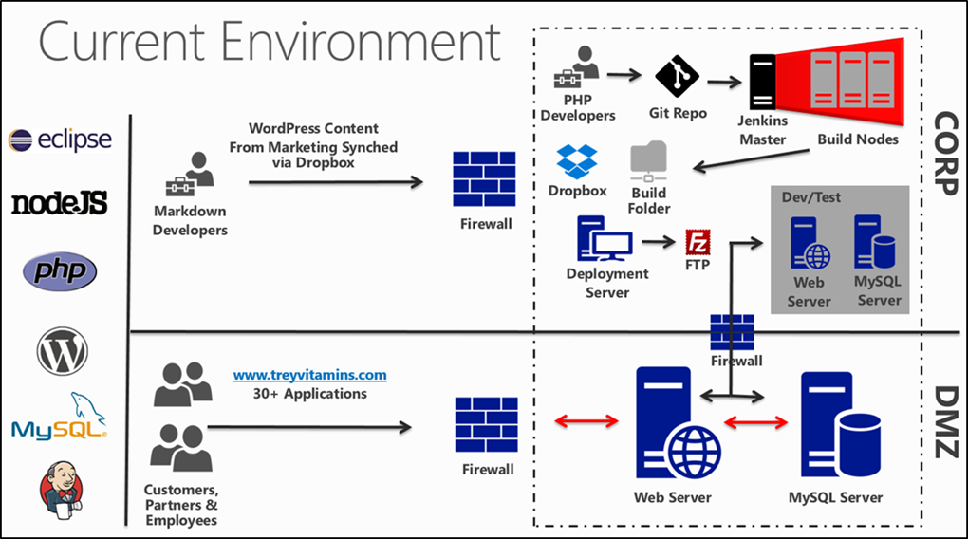
Trey Research environment

Slide 12
Customer needs
Easily deploy and scale their web applications.
Geo-redundant and scalable MySQL backend (active-passive).
Code validation from test environment leveraging investments in Jenkins, Git, and Dropbox.
No longer wants to manage build server environment on-premises.
Ensure that existing development tools are retained and compatible with any new solution.
Increase performance for remote users.
Lower total cost of ownership (TCO).
Notes:
Deploy and easily scale their web applications written in PHP, node.js and WordPress
A resilient, and scalable MySQL backend configured to span geographically distributed datacenters and it must support an active-passive setup.
A simpler method of deploying and validating code from their test environment leveraging their investments in Jenkins, Git and Dropbox
Ensure that existing Development tools are retained and compatible with any new solution
Avoid timeouts during busy periods while browsing their product catalog
Decrease the amount of time needed for remote users in areas like Asia to download graphic heavy static content and product catalogs which are PDFs
Lowering the total cost of ownership of the entire solution by minimizing the management surface area required for the solution

Slide 13
Customer objections
Is Azure only for Windows workloads?
What does Microsoft know about PHP & LAMP stack?
Can we debug our applications using Eclipse against Azure Web Apps?
We simply cannot move to Microsoft SQL Server, and we do not want to deal with the issues of the MySQL VMs anymore!
Notes:
Why use Microsoft Azure? Surely Azure is a Windows only cloud, because Microsoft sells the Windows operating system?
What does Microsoft know about PHP and the LAMP stack? They can’t offer support of these things whereas I know other companies that have successful deployments of this on Amazon.
If we move to the cloud, will we always be ready to take our customers’ orders?
We have a few settings in our php.ini and some of the applications use PHP extensions. They are critical to their functionality, so can we make custom settings and enable extensions like this if we use Azure Web Apps?
We primarily use Eclipse for our development and that is what our team using to debug issues. Can we debug our applications using Eclipse against Azure Web Apps?
We simply can’t move to Microsoft SQL Server, and we don’t want to deal with the issues of the MySQL VMs anymore.

Slide 14
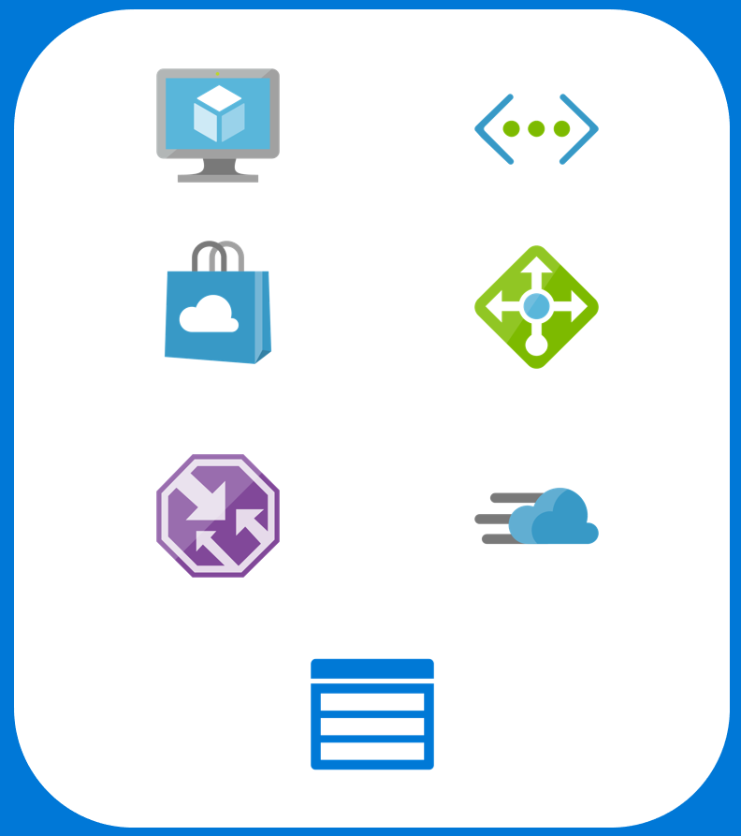
Common scenarios
Azure Infrastructure as a Service (IaaS)
Virtual Machines
Virtual Network
Jenkins (Image Gallery)
Load Balancers
Traffic Manager
Content Delivery Network
Storage
Notes:
In the following slides, we will touch on some Azure technologies that can and should be leveraged when thinking about the solution. In the corresponding Case Study document, you will also find links that elaborate even further on these topics.
In this slide we call out Azure infrastructure as a service (or IaaS) components – Virtual Machines & Virtual Networking (highlighting a couple of ways to connect to the Azure cloud – by way of a Site to Site Connection or a Point to Site connection)

Slide 15
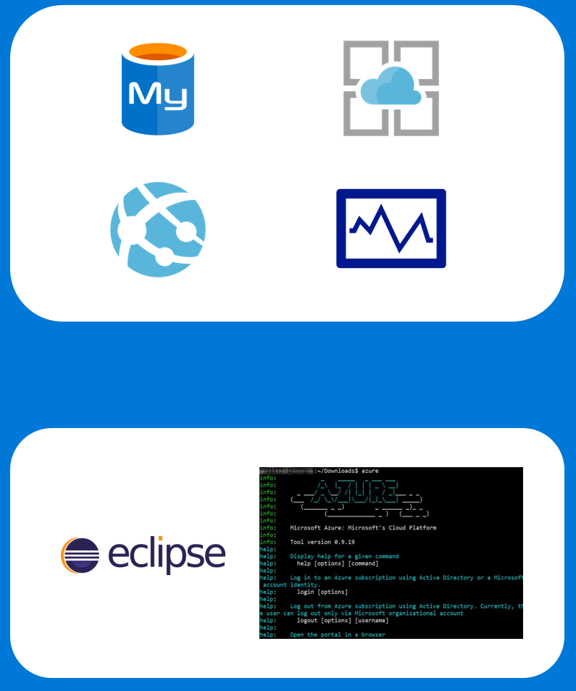
Common scenarios
Azure Platform as a Service (PaaS)
Azure Database for MySQL
App Service for Linux
Web Apps
Autoscaling
Additional Tools
Eclipse IDE
Azure Toolkit for Eclipse
Azure Command Line Interface
Notes:
In the following slides, we will touch on some Azure technologies that can and should be leveraged when thinking about the solution. In the corresponding Case Study document, you will also find links that elaborate even further on these topics.
In this slide we call out Azure infrastructure as a service (or IaaS) components – Virtual Machines & Virtual Networking (highlighting a couple of ways to connect to the Azure cloud – by way of a Site to Site Connection or a Point to Site connection)

Slide 16
Step 2: Design the solution
Outcome
Design a solution and prepare to present the solution to the target customer audience in a 15-minute chalk-talk format.
Timeframe
60 minutes
Business needs (10 minutes) | Respond to questions outlined in your guide and list the answers on a flipchart.
Design (35 minutes) | Design a solution for as many of the stated requirements as time allows. Show the solution on a flipchart.
Prepare (15 minutes) | Identify any customer needs that are not addressed with the proposed solution. Identify the benefits of your solution. Determine how you will respond to the customer’s objections. Prepare for a 15-minute presentation to the customer.

Slide 17
Step 3: Present the solution
Outcome
Present a solution to the target customer in a 10-minute chalk-talk format.
Timeframe
30 minutes (15 minutes for each team to present and receive feedback)
Directions
Pair with another table.
One table is the Microsoft team and the other table is the customer.
The Microsoft team presents their proposed solution to the customer.
The customer asks one of the objections from the list of objections in the case study.
The Microsoft team responds to the objection.
The customer team gives feedback to the Microsoft team.

Slide 18
Wrap-up
Outcome
Identify the preferred solution for the case study.
Identify solutions designed by other teams.
Timeframe
15 minutes

Slide 19
Preferred target audience
David Smith, CTO
Ursula Karalov , VP of Sales
Tim LaMar, Lead System Administrator
Development Leads
Operations Leads (includes networking)
Marketing Company Development Lead

Slide 20
Preferred solution
Web app infrastructure and network designs (Operations)
The preferred solution for this design starts with the move from single PHP and MySQL backend Server to using PaaS (Platform as a Service), solutions from Azure in the form of Azure Web Apps .
With the expansion to Asia there will be a geo-distributed architecture in Europe and Asia using Azure networking features of Traffic Manager and CDN to ensure the best experience across the board for Trey’s customers.
Management is minimized with the deployment of the application leveraging Azure Web Apps in the database being hosted by Azure MySQL.

Slide 21
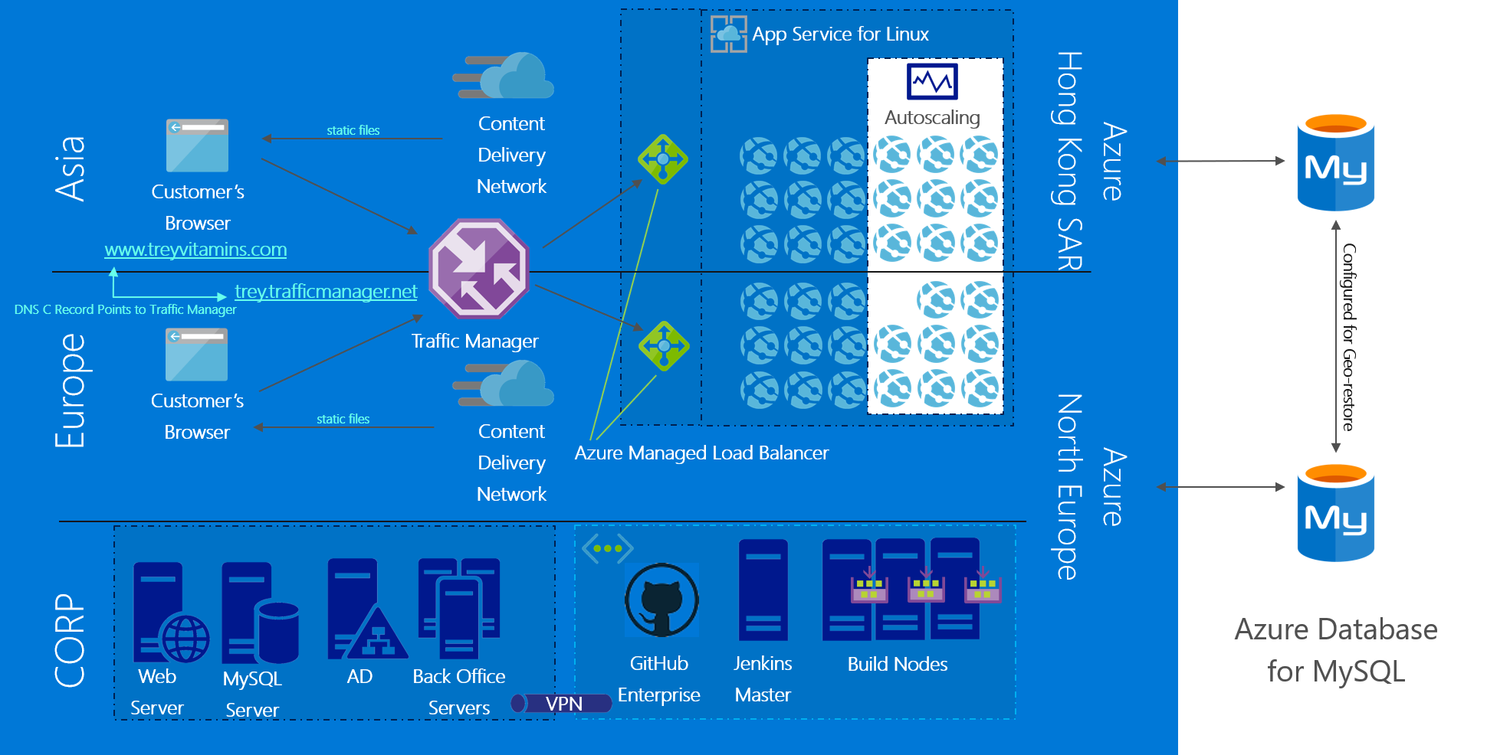
Preferred solution

Slide 22
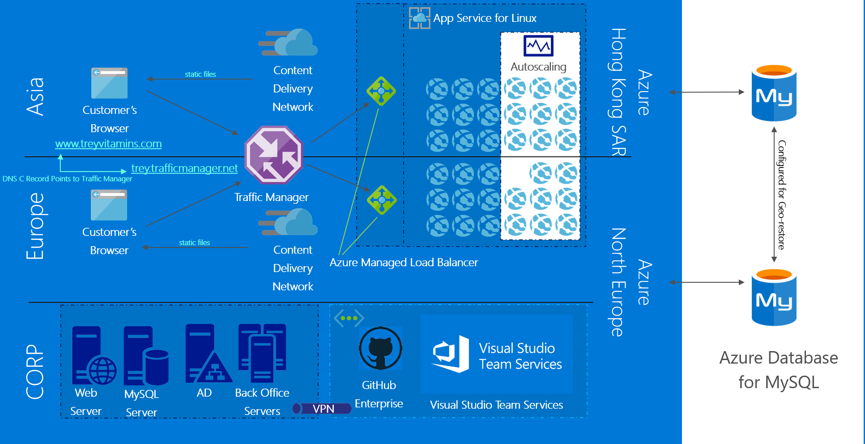
Additional solution
Notes:
This is an additional solution that simplifies the Azure environment by integrating (or completely replacing) the Jenkins infrastructure with Azure DevOps, thereby reducing the management overhead since there would be no servers to manage in this solution.
Azure DevOps Integration with Jenkins
Azure DevOps includes a growing list of preinstalled configurations. One of its integrations is with Jenkins. This allows using both CI systems with traceability through a single platform. Some example scenarios include:
Using Jenkins for continuous integration of Team Services Git repositories
Using Jenkins to validate Azure DevOps pull requests
Mixing Jenkins and Azure DevOps to perform builds and releases
Providing traceability between Jenkins and Azure DevOps; linking builds, pull requests, commits, and stories
There are multiple ways to use Jenkins as a CI server with Azure DevOps. Jenkins’ built-in Git Plugin can poll a Azure DevOps repository every few minutes and queue a job when changes are detected. For those who need a tighter integration, Azure DevOps provides two additional ways to achieve it: 1) the Jenkins Service Hook, and 2) Jenkins build and release tasks.
The Jenkins Service Hook in Azure DevOps automatically queues a Jenkins job when code changes are pushed to your repository. This is an improvement over polling because jobs are immediately queued.
Azure DevOps adds capabilities over the Jenkins Service Hook by including connectors that allow its build and release systems to integrate with Jenkins. These connectors can be chosen from the list of tasks to execute as steps in a Azure DevOps build or release definition.
In effect, an Azure DevOps build or release will queue a Jenkins job and download resulting artifacts. The Jenkins Queue Job task queues a Jenkins job by name. It can wait for the job to complete or immediately continue to subsequent steps.
When the option is selected to capture the Jenkins job’s console output, it is displayed live in AzureDevOps while the build executes. After the build completes, the console output is available in the VSTS logs.
Downstream jobs and multi-branch pipeline results are displayed in the Azure DevOps Build or Release Summary for traceability.
The Jenkins Download Artifacts task makes it easy to download build artifacts from Jenkins and integrate them in your Azure DevOps build or release process. Once artifacts are downloaded, they can be used by other tasks.
Jenkins can also independently trigger a Azure DevOps release. You can configure the Jenkins post-build action named Trigger release in Azure DevOps to initiate the release.
Then, you can set your Azure DevOps release definition to use artifacts from the Jenkins build. Artifacts will be downloaded from Jenkins and used in your Azure DevOps release pipeline.
Alternatively, you could simply replace your Jenkins installation and leverage the end-to-end features all within Azure DevOps using the built in tasks to build and deploy the solution.

Slide 23
Preferred solution
Web app infrastructure and network designs - application
Task: Design a scalable geo-distributed platform for the Trey Research web applications written in PHP, node.js, and WordPress.
Answer: Using Azure Web Apps in two regions we are able to meet the needs of Trey Research. There will be a set of Web Apps deployed in the Azure Northern Europe Region and another in the South East Asia Region that is located in Hong Kong SAR. By taking this approach, we are ensuring there will be Web Front ends close to current and future customers. Since Azure Web Apps support PHP, node.js, and WordPress, we can eliminate virtual machines for the web site deployment.

Slide 24
Preferred solution
Web app infrastructure and network designs - application
Task: The solution should scale automatically and be resilient to failures.
Answer: Configuring Web Applications to scale is very simple using Azure Web Apps. A set of criteria is easy to define and then Azure will take care of the hard work to ensure that the Web App is always responsive. This set of steps and easily completed by administrators based on a few different metrics such as CPU, memory, etc.

Slide 25
Preferred solution
Web app infrastructure and network designs - application
Task: Load times in locations around the world should be lessened as compared to today, and files should be placed as close to the user as possible.
Answer: Using Azure CDN Standard or Premium from Verizon we are able to preload files into nodes that are located closer to customers. It ensures that their load times will be less than if they were served directly by the web application. All static content will be preloaded, including images and PDFs among other items on the site.

Slide 26
Preferred solution
Web app infrastructure and network designs - application
Task: Ensure to document (at a high level), how the new design can handle custom settings in their php.ini and the use of PHP extensions.
Answer: The administrator should create a “.user.ini” file in the root of the Web App using Kudu and then create settings just as you would in the php.ini file of a Linux box. For the extensions, add a ‘ext’ directory to the d:\home\site directory on the web app and the put .dll extension files into the ext directory.

Slide 27
Preferred solution
Web app infrastructure and network designs - database
Task: Design a resilient and scalable MySQL backend configured to span geographically distributed datacenters. The solution must include backups and the ability to restore to a different region.
Answer: By creating the Web App + MySQL, Trey Research is able to select Azure Database for MySQL for this application. MySQL supports Azure as a provider of MySQL PaaS Services. It also supports business continuity features including automated backups and the ability for users to initiate geo-restore.

Slide 28
Preferred solution
Web app infrastructure and network designs - network
Task: Design a hybrid network (at a high-level) that that will allow you to meet all of the customer requirements and support your design for moving Trey Research to Azure.
Answer: Using a site-to-site VPN between their corporate location and the Northern Europe Azure Region, the networks will be connected privately (hybrid cloud connectivity). The Jenkins Master and agent nodes along with a new GitHub Enterprise server will be implemented in the VNET in Azure North Europe. It will allow for the use of bursting number of Jenkins agent nodes on demand and ensure 99.95% update based on the Azure SLA.

Slide 29
Preferred solution
Web app infrastructure and network designs - network
Task: Design a virtual network in Azure and establish hybrid connectivity between Trey Research on-premises to Azure.
Answer: Site-to-site VPN from corporate location to Azure Northern Europe. Various options are available to enable different amounts of bandwidth and degrees of resiliency.

Slide 30
Preferred solution
Web app infrastructure and network designs - network
Task: Include Azure Networking features in the design to ensure users connecting to the Web Application are routed to the front-end with the least number of hops and that the load is balanced across these servers.
Answer: Traffic Manager should be implemented to route DNS traffic to the either of the Azure regions based on Performance or Geography. Performance will calculate the number of hops between the user and each of the Azure Web App frontends and direct the traffic to the one with the least number of hops. The Geography routing method directs users to endpoints in their geographic region.
Since Azure Web Apps automatically manage the Load Balancer for the application no additional configuration is required.
To ensure that static content loads a quickly as possible the Azure CDN will be leveraged. By placing static content such as site pictures and PDFs on CDN endpoints you get the best loading experience possible.

Slide 31
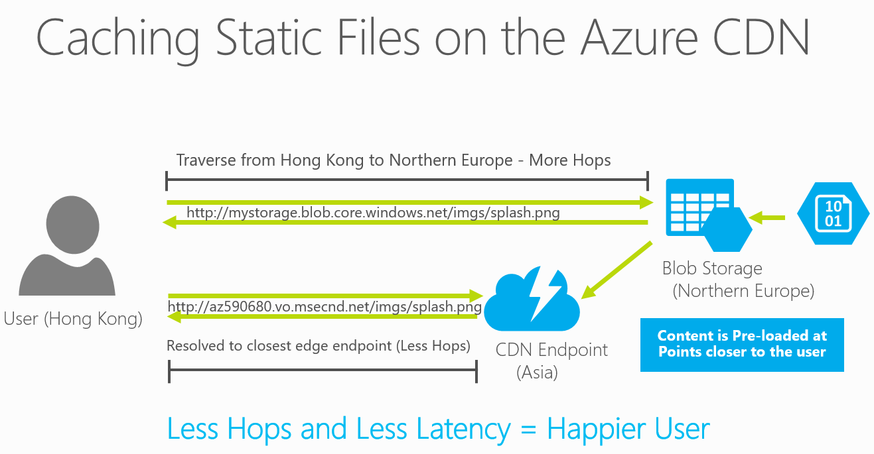
Preferred solution

Slide 32
Preferred solution
DevOps in Azure implementation (Development)
Using the features of Azure and the requirements to use Dropbox, Git, and Jenkins as a part of the solution, design a DevOps pipeline workflow that the Development Team will use to move from test, staging, and to production.
Task: Document the workflow at a high-level that will be used to implement a CI/CD pipeline at Trey Research.
Answer: Code checked into GitHub and content placed in Dropbox will be picked up by Jenkins and built, then it will be copied to the infrastructure using the Azure CLI.

Slide 33
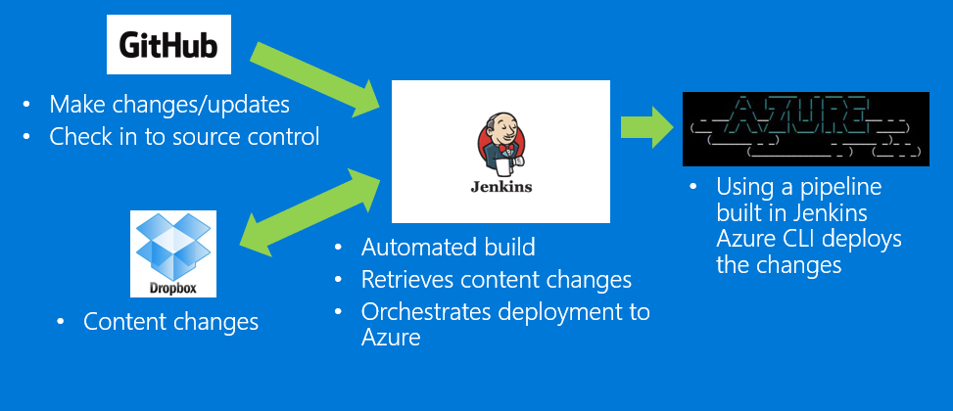
Preferred solution CI/CD workflow

Slide 34
Additional solution CI/CD workflow
Using Azure Pipelines release management tasks to trigger automated deployments to Azure
Content changes trigger automated build
Using Azure Pipelines build tasks to create artifacts
Notes:
You could simply replace your Jenkins installation and leverage the end-to-end features all within Azure DevOps using the built-in tasks to build and deploy the solution.

Slide 35
Additional considerations
CD/CD workflow
Propose the solution that best fits customer needs & OSS preferences:
Customer can use OSS tools in Azure IaaS
Customer can use Azure DevOps with Jenkins integration
Customer can switch to Azure DevOps
Customers not familiar with Visual Studio and Azure DevOps can use Azure DevOps projects to to setup CI/CD from Azure portal
GitHub acquisition will remain a separate service/product with additional integration points coming for deployment and use with Azure services
Notes:
Additional considerations
CD/CD workflow
Propose the solution that best fits customer needs & OSS preferences:
Customer can use OSS tools in Azure IaaS (still needs administration, maintenance and customization)
Customer can use Azure DevOps with Jenkins integration (leverage investment in Jenkins build but use Azure Pipelines release management as a fully managed service)
Customer can switch to Azure DevOps (best integration and open standards, Linux/macOS & Windows Build and Release, fully managed service)
Customers not familiar with Visual Studio and Azure DevOps can use Azure DevOps projects to to setup CI/CD from Azure portal
GitHub acquisition will remain a separate service/product with additional integration points coming for deployment and use with Azure services

Slide 36
Preferred solution
DevOps in Azure implementation (Development)
Task: Where is code checked in, how does the code get built and then how does it deploy to the Site? Make sure to take into account not only the in-house developers, but also the marketing vendors code. Note that they marketing team is not going to move from using Dropbox.
Answer: Code will be checked into GitHub and content place in Dropbox which is then picked up by the Jenkins plugins, moved through a custom pipeline in Jenkins to build the code, and make any other transformations required for its deployment. Once this process has been completed, Jenkins will then use custom bash scripts calling the Azure CLI to move the files into place across the Azure Web App and CDN endpoints.

Slide 37
Preferred solution
DevOps in Azure implementation (Development)
Task: Design a “Slotting” methodology using at least three slots for test, staging, and production? How does code land on each of these sites? Show the full workflow from code check-in, build, deployment, and then promotion to production.
Answer: Once codes goes through the pipeline, it will land on the Test slot of the Web App. The code will then be accessible via the Test URL for that slot. From there, the testers will be able to review the site to ensure that it is ready to move to production. Once testing is completed, code will be promoted to the Staging Slot. It can then be swapped into production.

Slide 38
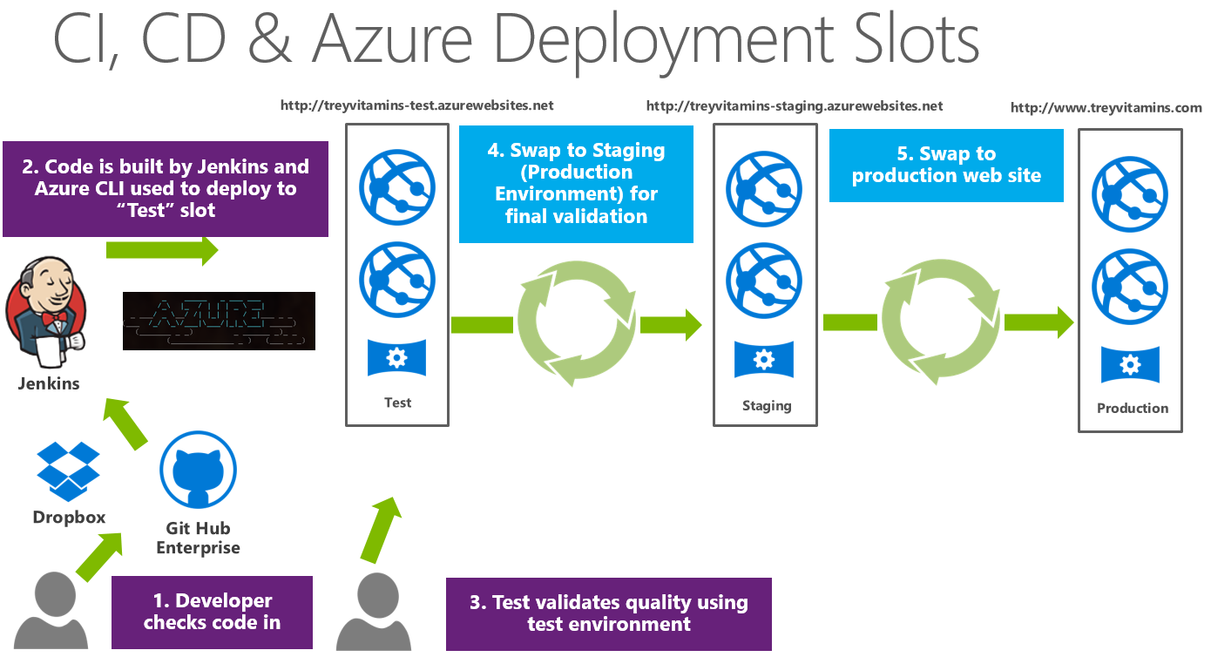
Preferred solution

Slide 39
Preferred solution
DevOps in Azure implementation (Development)
Task: Document how Trey Research can continue to use Eclipse as their development environment. Document how the tools are compatible with the new design.
Answer: Eclipse is supported for use with Azure Web Apps in Azure by using the Azure Toolkit for Eclipse.

Slide 40
Preferred solution
DevOps in Azure implementation (Development)
Task: Determine how their client can debug issues. Can we debug our applications using Eclipse against Azure Web Apps?
Answer: Azure Web Apps support the connection of the Eclipse environment directly to debug applications.

Slide 41
Preferred solution
DevOps in Azure implementation (Development)
Task: Document how Trey Research could build nonproduction Azure Web Apps that are “proof of concepts”, so they can implement their alpha code directly to Azure by-passing the CI/CD infrastructure.
Answer: Trey Research can create separate Azure Web Apps that are not included as a part of the production sites. Using the Eclipse environment including the Azure Toolkit, the developers can publish their site directly from Eclipse. It allows for them to do “proof of concepts” without having to do the full integration Git and Jenkins. It will ensure a fast start for these projects and the Development team can do it without involving the Operations team.

Slide 42
Preferred objections handling
Objection:
Why use Microsoft Azure? Surely Azure is a Windows only cloud, because Microsoft sells the Windows operating system?
Potential answer:
Azure is an Open Source friendly cloud that supports PHP, node.js, WordPress, MySQL among many other OSS projects. There is no reason to believe that Microsoft is Windows only focused anymore. Microsoft has Open Sourced many of their closest held products include .NET and ASP.NET and all of the Azure SDKs and client tools. In addition, Microsoft has joined the Open Compute Project and the Eclipse foundation.

Slide 43
Preferred objections handling
Objection:
What does Microsoft know about PHP and the LAMP stack? They cannot offer support of these things whereas I know other companies that have successful deployments of this on Amazon.
Potential answer:
Microsoft has supported PHP and the entire LAMP stack on Azure from the beginning of both the PaaS and IaaS services. There is full support for all of these products.

Slide 44
Preferred objections handling
Objection:
If we move to the cloud, will we always be ready to take our customers’ orders?
Potential answer:
Moving to the cloud should never be seen as a panacea to application or operations issues. However, Azure has exponentially reduced the complexity of integrating redundancy and content acceleration into common workloads. The platform has made resilient deployments approachable for all types of businesses from a cost perspective.

Slide 45
Preferred objections handling
Objection:
We have a few settings in our php.ini and some of the applications use PHP extensions. They are critical to their functionality, so can we make custom settings and enable extensions like it if we use Azure Web Apps?
Potential answer:
Microsoft supports the ability to add settings to the php.in files and enable PHP extensions. It will not be a blocker to moving to Azure Web Apps.

Slide 46
Preferred objections handling
Objection:
We primarily use Eclipse for our development, and that is what our team using to debug issues. Can we debug our applications using Eclipse against Azure Web Apps?
Potential answer:
The Azure Toolkit for Eclipse allows for both the publishing and debugging of applications directly on Azure Web Apps. Trey Research should be able to easily continue to use the Eclipse toolset.

Slide 47
Preferred objections handling
Objection:
We simply cannot move to Microsoft SQL Server, and we do not want to deal with the issues of the MySQL VMs anymore.
Potential answer:
It is not an Issue as Azure supports MySQL Platform as a Service (PaaS), via Azure Database for MySQL.

Slide 48
Customer quote
“By using Azure PaaS Services, Azure Database for MySQL, and multiple regions we are now able to both scale and support our CI/CD needs. Using the images from the Azure Market Place for Jenkins and GitHub Enterprise allowed for a rapid migration to Azure.”
—David Smith, CTO, Trey Research

